Slide 1
平時報告
數字辨識 深度學習實務
4050D028 蘇偉哲
偉大的恩師 曾龍

Slide 2
使用的工具以及函數
from Tensorflow.python.client import device_lib
import keras
from keras.datasets import mnist
from keras.models import Sequential
from keras.layers import Dense, Dropout, LeakyReLU, Conv2D
from keras.optimizers import RMSprop
from keras import backend as K
from matplotlib.pyplot import imshow
import Numpy as np
呼叫 工具
Tensorflow
keras
python
Numpy

Slide 3
MNIST 資料集
(x_train, y_train), (x_test, y_test) = mnist.load_data() //總資料
x_train = x_train.reshape(60000, 784) # 28*28=784 //輸入資料
x_test = x_test.reshape(10000, 784) # 28*28=784 //測試資料
x_train = x_train.astype('float32‘)
x_test = x_test.astype('float32')
x_train /= 255 //0到255 影像 有時會寫 2D
x_test /= 255
y_train = keras.utils.to_categorical(y_train, num_classes)
y_test = keras.utils.to_categorical(y_test, num_classes)

Slide 4
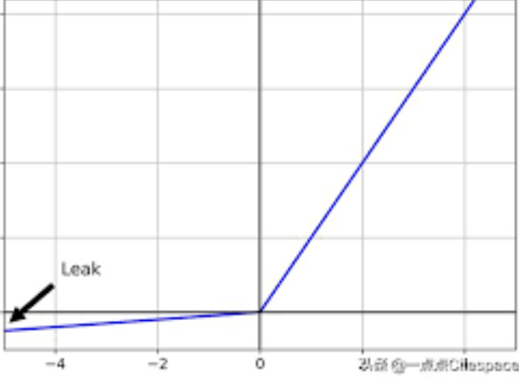
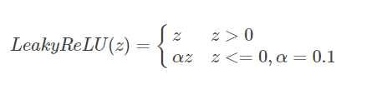
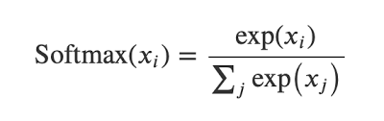
程式講解
LeakyReLU :
設一層隱藏層(Dense)
model = Sequential()
model.add(Dense(20, activation=LeakyReLU(), input_shape=(784,))) #28*28
model.add(Dense(20, activation=LeakyReLU()))
model.add(Dense(10, activation='softmax'))
model.summary()
model.compile(loss=‘categorical_crossentropy’,optimizer=RMSprop(), metrics=['accuracy'])
選擇損失函數(loss)
優化方法(optimizer)
成效衡量方式(metrics)
Softmax :

Slide 5
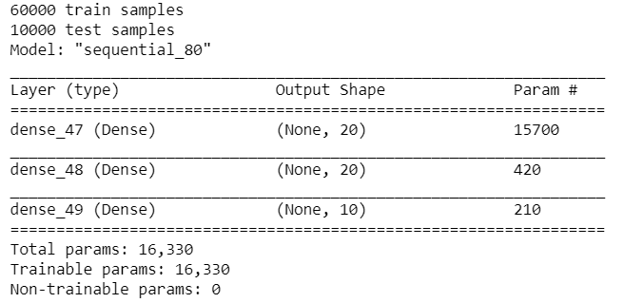
程式講解
執行後畫面
batch_size = 128 //資料大小
num_classes = 10
epochs = 10 // 重複次數
history = model.fit(x_train, y_train,
batch_size=batch_size,
epochs=epochs,
verbose=1,
validation_data=(x_test, y_test))//測試資料

Slide 6
參考文獻
https://blog.csdn.net/csuyzt/article/details/82320589
https://ithelp.ithome.com.tw/articles/10191404
https://ithelp.ithome.com.tw/articles/10191404
http://shangdixinxi.com/detail-1100049.html

